Slide 1
Developing a Weather App using Tkinter
By Batch 9

Slide 2
Introduction
As we delve into weather app development, Python emerges as a compelling language, blending simplicity with a rich ecosystem of libraries. This introduction sets the stage for exploring Python's versatility, making it a robust foundation for creating user-friendly and feature-rich weather applications. Let's embark on a journey to harness Python's power for meteorological insights.

Slide 3
What is Tkinter?
Tkinter stands as Python's standard GUI (Graphical User Interface) library, providing a straightforward toolkit for building interactive applications. Noteworthy for its simplicity and ease of use, Tkinter is particularly well-suited for beginners, offering a gentle introduction to GUI development while enabling the creation of visually appealing and functional interfaces.

Slide 4
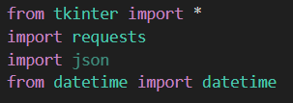
IMPORTING DATA FROM TKINTER
Here, first we need to import the tkinter files along with API keys to get the data related to our weather report. Along with which json is used to import javascript objects in python configuration files, stories some data or commonly for API.
Json = Java Script Object Notation

Slide 5
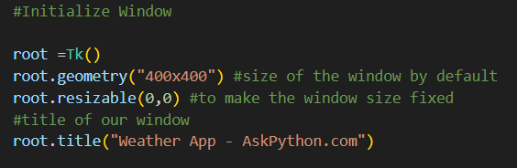
INITIALIZING THE OPENING WINDOW
Now for designing the window for our weather app, some parameters like its geometry, title and resizability must be defined using this code.

Slide 6
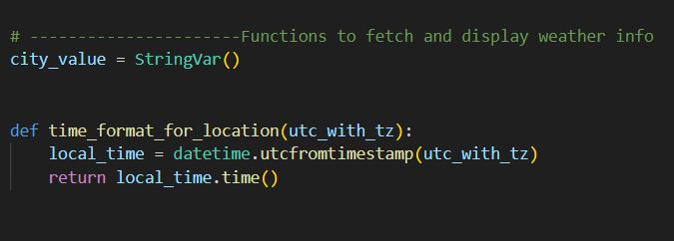
INPUT CODE FOR TIME FORMAT ACCORDING TO IT’S LOCATION
Here we used a function to fetch the accurate time format because we needed to make it accurate for every location placed on different longitudes.

Slide 7
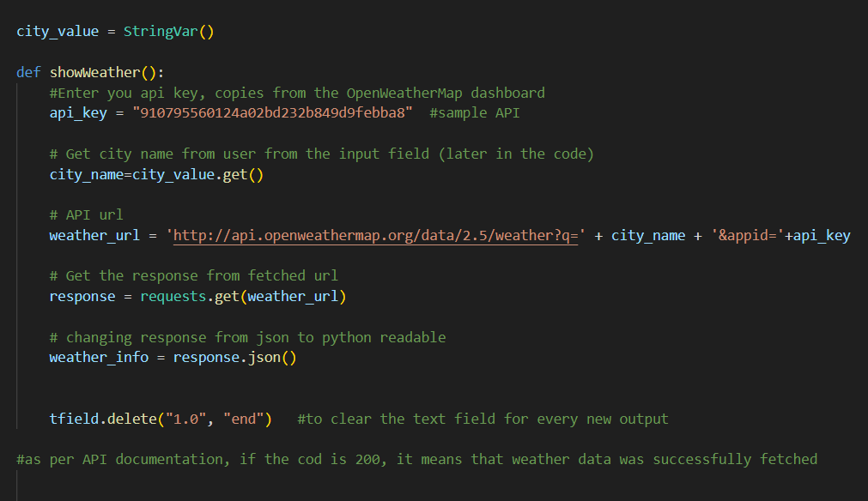

Slide 8
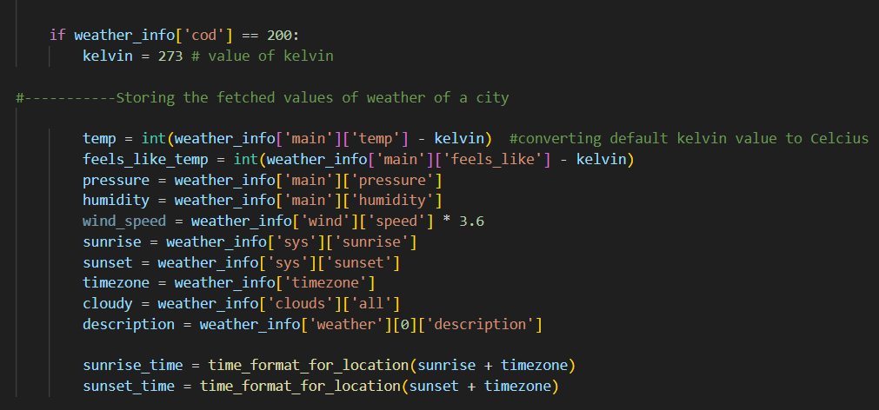
CREATING THE DESCRIPTION BOX
The main output we needed to describe the info for given city will be coded in this manner. Factors like feels like temperature, pressure, humidity, cloud formation are add-ups to our temperature output.

Slide 9
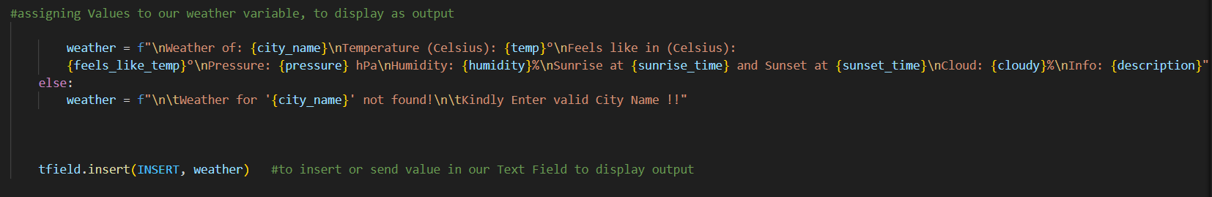
ASSIGNING THE INFO IN OUTPUT
Here the code represented assigns the data collected from API for the particular city and will display the output on our weather window. One more code is added here for inappropriate or false entry of the city name so as to prevent misinformation.

Slide 10
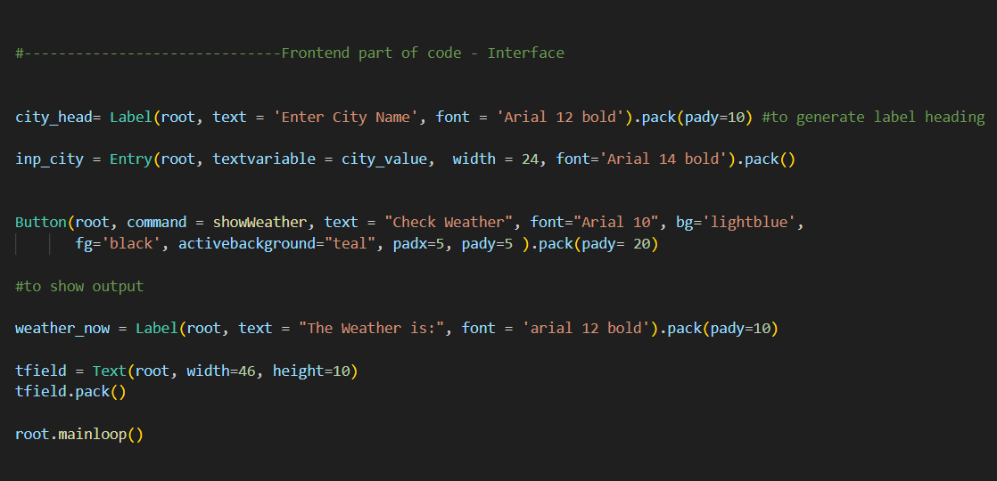
FINISHING WITH LABELS AND CHECK BUTTON
Finishing off with the check button which will generate the output and labelling the comments for the user to guide through will the last task to code. Other texts like size, shape and color of the button gives us the complete app we needed.

Slide 11
SUMMARY
The weather app's user interface features a clean design with a city entry field and a prominent “Check Weather" button for simplicity. The central display area provides real-time information, showcasing the temperature, weather conditions, humidity, and wind speed, creating an intuitive and user-friendly experience for accessing essential data.

Slide 12

To check the weather update through our newly made app please scan the QR code and tell us your thoughts over making it better. Kindly use VS code (Visual Studio code) to get the best results or it may give you some errors on other compilers.

Slide 13
THANK YOU
MADDIRALA BALA SIVA MANIKANTA(23BAI11066)
HARSHIMA BARNWAL(23BAI11080)
JHANVI JYANT(23BHI10169)
PURVA PATIL(23MIM10162)
BHUMIKA PATIL(23MIM10177)

